Slide 1
Project presentation: I6Bureau(International interbank investment bureau)
Contacts: Pavlova Ekaterina pavlova_ev@pspr.ru

Slide 2
Libretto.

Slide 3
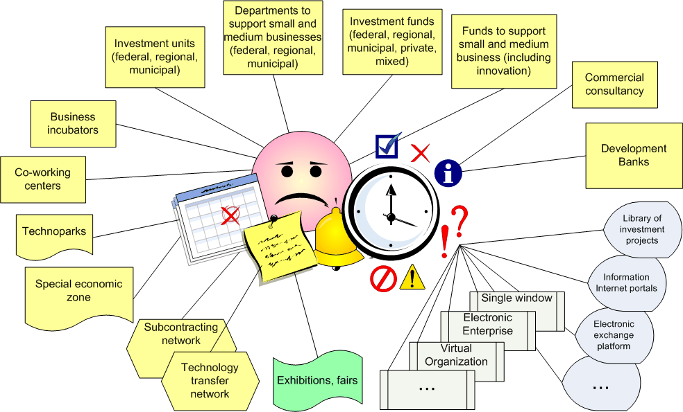
The applicant's navigation problem.
This slide illustrates how difficult it is for a common applicant to understand all the peculiarities of various institutions and the way they function. Where to go if you have your own idea or project, if you want to find financing and exports. The main problem is that there are too many of these structures. The picture illustates this situation.

Slide 4
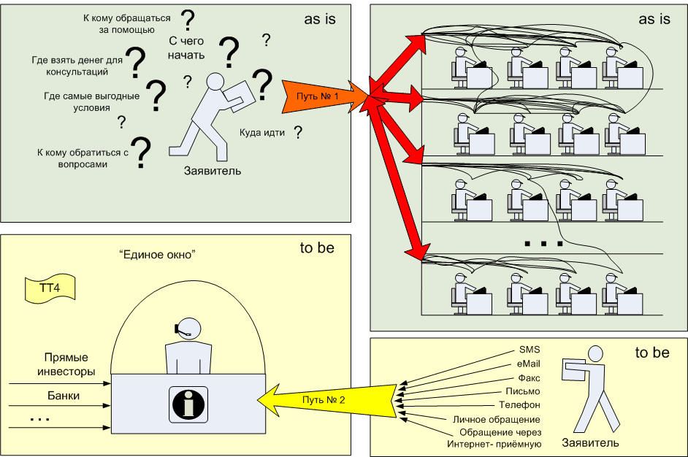
The applicant's navigation problem and «Single Window».
The same problem as on the previous slide is illustrated here. How to solve it? The solution proposed is to create a “Single Window” for applicants. This technology is now widely used in the housing and communal sphere. We’d like to try to apply this solution to the financial sphere. As we see in the picture «As it is» there are a lot of problems and questions on where to go with your project. In «will be» there is one place where you can go and ask all your questions. No more waiting and time wasting.

Slide 5
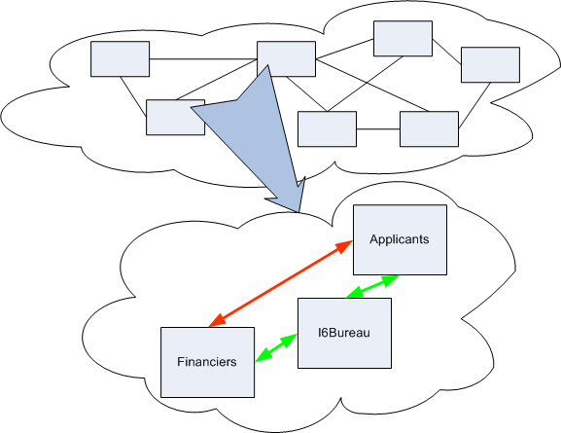
Informational metabolism and institutional construction.
As we suggest using an institutional solution to the problems mentioned above, we'd like to show its pros. 1st, institutional solutions can be used many times, being a long-term investment. 2nd, today, the age of knowledge economy introduces itself to us, but in fact, nowadays there are no institutions to correspond to this age. In our work we tried to explain the principles of new institutions construction using informational metabolism. There are two illustrations on the slide: On the first one you can see spontaneously-set connections between 2 objects (in our case between applicants and financiers). Such an interaction is ineffective for several reasons and the main is the difference in goals between these objects, persons, organizations. Let's call this reason the problem of ineffective interaction between a. and financiers).The 2nd illustration (the one below) again shows the connections between applicants and financiers. But in the this case their interaction is efficient, because there is an additional “link” agent between them (I6Bureau). It helps applicants and financiers to deal only with their own tasks (developing new projects and giving loans- respectively). I6Bureau assumes responsibility for all the other problems like negotiating with financiers and documents execution.
So what is I6Bureau? I6Bureau is an organization, an agent between applicants and financiers, which helps both sides. It helps the applicants to bring their projects(ideas, business-plans or any other stage of the project) to a “salable” condition and helps to find financing. Financiers are helped to find interesting projects, independent project expertise. On this picture we see the organizations that will be part of I6Bureau (or international interbank investment bureau, which are synonyms, as we’ve already said).

Slide 6
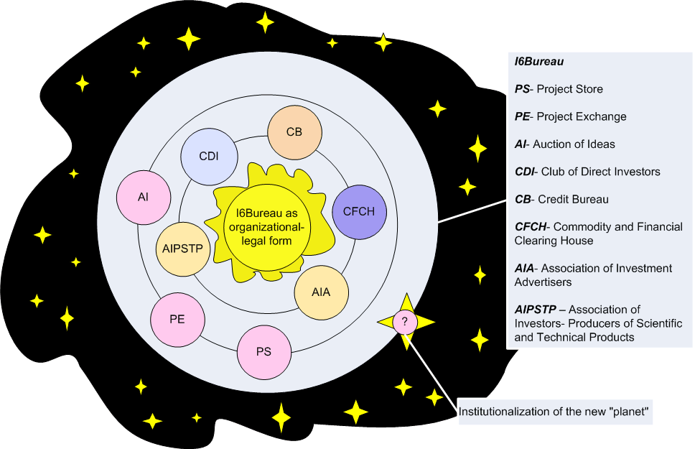
What I6Bureau includes?
I6Bureau is an organization, an agent between the applicants and financiers, which helps both parts. Applicants are given assistance to bring their project (idea, business plan, any life-cycle) to "commodity" type and funding. Financiers are provided assistance in finding interesting projects, an independent review. At this figure, we see organizations that will be part of I6Bureau (or international interbank investment bureau, which is synonymous, as we wrote).

Slide 7
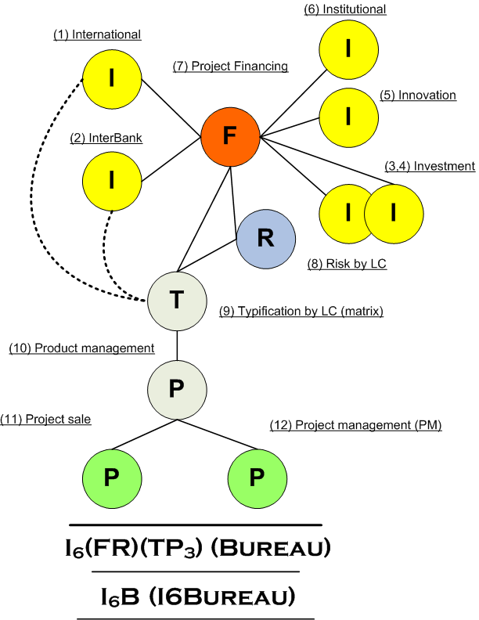
So how does I6Bureau work?
We’ve tried to deduce the I6Bureau formula which looks like a chemical formula. That’s why we chose English terms, cut them short to only the first letter of each and thus made up the formula : IIIIII (6 I letters) Bureau. These are the key words: - international - institutional - innovation - investment & investment* - interbank So we get I6+Bureau . Other letters in this pic are (they show the main I6Bureau work principles)**: - T (typification) - P (product management) - P (product shop) - P (project management) - P (project financing) So we get the explicit IIIB formula: I6FTP3 Bureau You can get more information about it in full presentation. In our work we’ve tried to get a new way of risk-model, that will make risks lower. The problem is that the models that banks use are surely good, but they don't meet the needs of project financing. We only tried to get a new model. It's only an attempt to say that maybe the new model is needed here and then other results about making decision about * The main thing that we should mention here is that the word “investment” is different for f_and_a. They have different views on it. You can read more about it in the full presentation. ** Excuse us for the concise character of the presentation. Our task was to point out the main ideas of I6FTP3 Bureau. You’ll find the full version of the material in detail on our web-site.

Slide 8
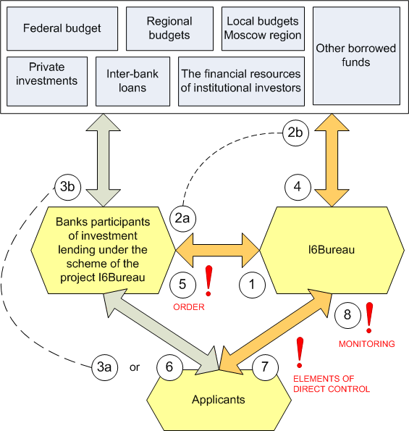
The main scheme of I6 Bureau work.
Here you can see the main scheme of I6Bureau work (financial, organization, informational flows of the main business process). Let's have a look at two of them- financial and informational flows. There are 2 ways: Short one: from 1,2a,3a (1) Informational flow from the Applicant to I6Bureau; (2a) Passing information to the bank and here we’ve shown the variant when a bank invests its own money. (3) Bank transfers money to the Applicant. The minimal chain is over. Long one: From 1 to 8 (you can read more about it in the full version of the document). I6Bureau just has the right to dispose of cash tranches.

Slide 9
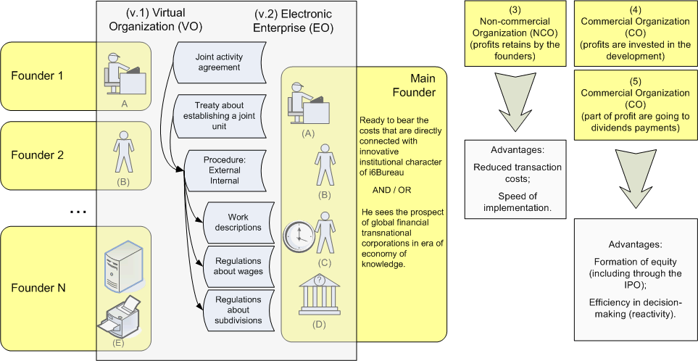
Organizational and legal aspects of I6Bureau.
We suggest a “option menu”: 5 variants of structural and legal aspects of activity I6Bureau at the first stage: Virtual Organization (VO), Electronic Enterprise (EE) Non-commercial Organization (NCO), 2 formats of commercial organizations.

Slide 10
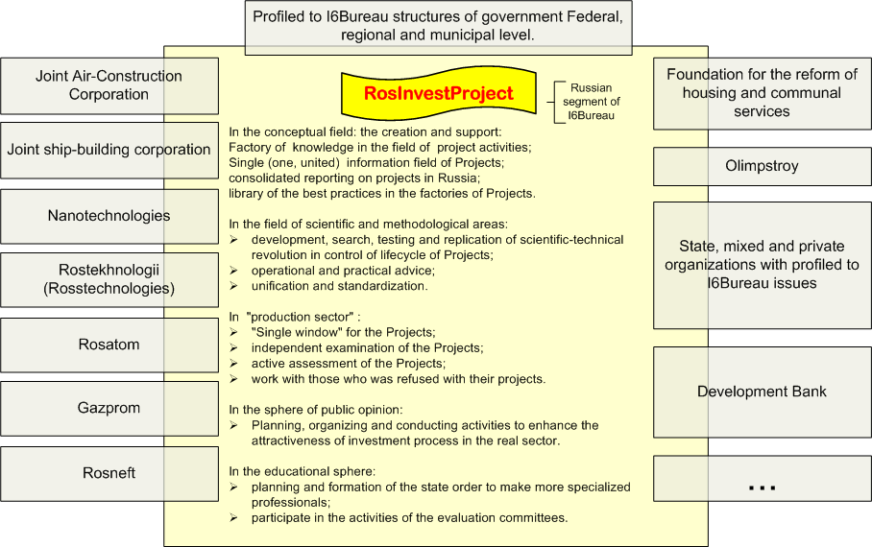
I6Bureau integration into the Russian organizations system, organs of state and local governing.

Slide 11
Reserches carried out. In the network of this work a number of researches has been made. 1.) Applicant’s questioning 2.) Financiers questioning 3.) Frequency of using words and word-combinations in the Presidents’ of Russia speeches from 1.1.1999 to 31/12/2009 4.) Territorial and geographical aspects of I6FTP3 Bureau activity. You can find the main result on the website Results approbation. 1.) 02.23.2009. Performance at Lomonosov Readings in “Education in innovative business and enterprise sphere” with the topic “Institutional innovations in the Russian market”. 2.) 05.18.2009. Performance at the “Technology of success” conference at Moscow State Aviation Institute. The conference was part of the “Youth year” and was dedicated to the innovative activity development (a letter of thanks for the active participation in the conference was received). 3.) Discussion of this work during the research which involved I6Bureau potential Partners (Appliera and Financiers). All the remarks and suggestions have been taken into consideration. 4.) Defense of a graduation project at Lomonosov Moscow State University (Economics Faculty,Iinnovations Department) with the topic: “Institutional innovations in the Russian market by example of I6Bureau”
Research and results approbation..

Slide 12
Thank you for your attention!

